Slide 1
LECTURE
Sequence Diagram
Waris Ali

Slide 2
Analysis Concepts: Dynamic models
Entity Objects
  Represent the persistent information tracked by the system (Application domain objects, “Business objects”)
Boundary Objects
  Represent the interaction between the user and the system
Control Objects:
  Represent the control tasks performed by the system
<<entity>>
<<control>>
Year
ChangeDateControl
<<boundary>>
ButtonBoundary
<<entity>>
Month
<<boundary>>
<<entity>>
LCDDisplayBoundary
Day

Slide 3
Analysis Activities: Identifying Entity Objects
Participating Business Objects/classes
  Examine each use case: identify candidate objects
    Represents things that are to be stored in Database.
Natural language analysis: Abbott
  Identifying objects, attributes, and association
Abbott’s Heuristics maps
  Part of speech to model components

Slide 4
Analysis Activities: Identifying Entity Objects
Use case name ReportEmergency
Entry condition 1. The FieldOfficer activates the “ReportEmergency” function of her terminal.
Flow of event 2. FRIEND responds by presenting a form to the officer. The from includes an emergency type menu (general emergency, fire, transportation), a location, incident description, resource request, and hazardous material fields.
3. The FieldOfficer completes the form by specifying minimally the emergency type and description fields. The FieldOfficer may also describe possible responses to the emergency situation and request specific resources. Once the from is completed, the fieldOfficer submits the form by pressing “Send Report” button, at which point, the Dispatcher is notified.
4. The Dispatcher is reviews the information submitted by the FieldOfficer and creates an Incident in the database by invoking OpenIncident use case. All the information contained in the FieldOfficer’s form is automatically included in the incident. The Dispatcher selects a response by allocating resources to the incident (with the AllocateResources use case) and acknowledges the emergency report by sending a FRIENDgram to the FieldOfficer.
Exit condition 5. The FieldOfficer receives the acknowledgement and the selected response.

Slide 5
Textual Analysis using Abbot‘s technique
Part of speech
Model component
Examples
Prpoer noun
Instance
Alice
Common noun
Class
FieldOfficer
Doing verb
Operation
Creates, submits, selects
Being verb
Inheritance
Is a kind of, is one of either
Having verb
Aggeragation
Has, consists of , include
Modal verb
Constarints
Must be
Adjective
Attribute
Incident description

Slide 6
Entiyt object for the ReportEmergency use case
Analysis Activities: Identifying Entity Objects
Dispatcher
EmergencyReport
FieldOfficer
Incident

Slide 7
Analysis Activities: Identifying Boundary Objects
System interfaces with actors
Collect information from the actor and translate it into a form that can be used by other objects in the system
Heuristics for identifying boundary objects
Identify data entry forms/windows (e.g. EmergencyReportForm, ReportEmergencyButton)
Identify messages system sends to user (e.g., AcknowledgementNotice)
Use the user’s terms as opposed to implementation terms

Slide 8
Analysis Activities: Identifying Control Objects
Coordinate between boundary and entity objects
Usually do not have a real world counterpart
Relate closely to use case
Responsible for collecting information from boundary objects and relaying it to entity objects
Heuristics for identifying control objects
Identify a small number of control objects per use case. Each flow of events should have a control object.
Identify a control object for each actor
A control object should exist for only one use case. (Its lifespan should be just one use case.)

Slide 9
Class Assignment
Login( Use-case ) To Yahoo Account
Write down Complete Scenario in steps.
Identify the boundary, entity, and control object.

Slide 10
Analysis Activities: Login to Internet Account Example
Actor: Customer
Use case - flow of events
  The customer clicks the login button on the home page.
  The system displays the login page.
  The customer enters his/her user ID and password and clicks the OK button.
  The system validates the login information against the accounts data.
  The system returns the customer to the home page.
Entity objects
  Customer
  Account
Boundary Objects
  Home page
  Login page
  Buttons
Control Objects
  Display

Slide 11
Dynamic Modeling
Definition of dynamic model:
  The behavioral view of a system:
Sequence Diagram
  shows interaction between classes and object in a time ordered way
Purpose:
  Detect and supply methods for the object model
How do we do this?
  Start with use case or scenario
  Model interaction between objects => sequence diagram

Slide 12
Dynamic Modeling with UML
Diagrams for dynamic modeling
  Interaction diagrams describe the dynamic behavior between objects
  Statecharts describe the dynamic behavior of a single object
Interaction diagrams
  Sequence Diagram:
    Dynamic behavior of a set of objects arranged in time sequence.
    Good for real-time specifications and complex scenarios
  Collaboration Diagram :
    Shows the relationship among objects. Does not show time
State Chart Diagram:
  A state machine that describes the response of an object of a given class to the receipt of outside stimuli (Events).
  Activity Diagram: A special type of statechart diagram, where all states are action states
Notes:
Parts of the DAIMLER system has a rich dynamic behavior, so the dynamic model is important.
Note that the dynamic model is an abstraction like the other models as well. Depending on what properties are most characteristic in a system, one of the models will be richer or more significant than others. If you have a choice to decide on a single model, which one would you use?
Object Model: Database, Preventive maintenance,
Dynamic Model: Communication, Notification Server, AGTS Server, Change management (Information flow!)
Temporal relationships are difficult to understand. Rumbaugh thinks, that a system can be best understood by first examining its static structure, that is the structure of its objects and their relationships to each other at a single moment in time. Then we examine the changes to the objects and their relationships over time. (Note that not everybody thinks that way. Heraklit: Everything flows (requires dynamic modeling first), Jacobsen: Use cases (Functional description)
Control is that aspect of a system that describes the sequences of operations that occur in response to external stimuli, without consideration of what the operations do, what the operate on or how they are implemented.
The major concepts of dynamic modeling are events which represent external stimuli and states, which represent the values of objects.
We will use state diagrams, which are a standard computer science concept. Question: Who does not know what a finite state automaton is?
In general we assume, that FSA are covered in 15-211 (Algorithms and Datastructures)
Similar to the problem in object modeling, we need to avoid to clutter our state diagrams (spaghetti diagrams). We will show that states and events can be organized into generalization hierarchies that share structure and behavior.

Slide 13
Classes from Dynamic modeling
How to identify classes from dynamic models
Sequence diagrams
  Distribution of behavior of use cases among participating objects.
  Model sequence of interactions among objects.
  Activity lines in sequence diagrams are candidates for objects.
State chart diagrams
  Actions and activities in state chart diagrams are candidates for public operations in classes
Notes:
Goal: Come up with
> a domain model (domain specific objects)
> a taxonomy (class hierarchy)

Slide 14
What is an Event?
Something that happens at a point in time
  Example “the WatchUser presses the left button”
Relation of events to each other:
  Causally related: Before, after,
  Causally unrelated: concurrent
An event sends information from one object to another

Slide 15
Mapping Use Cases to Objects with Sequence Diagrams
Sequence diagrams tie use cases and objects together
AKA Interaction Diagrams – Semantically equivalent to Collaboration Diagrams
Dynamic Model relating use cases and class diagrams
Illustrates how objects interacts with each other
Shows time ordering of interactions
Generally a set of messages between collaborating objects
Ordering of objects not significant

Slide 16
Sequence Diagrams
Show only one flow of control
Can model simple sequential flow, branching, iteration, recursion and concurrency
Objects that participate in use case form columns
  Vertical dashed line is called the lifeline
Time progresses from top to bottom
Horizontal arrows represent messages sent from one object to another
Rectangles represent the activation of an operation

Slide 17
Heuristics for drawing sequence diagrams
Actor who initiates – on the left
Next - the boundary object that the actor uses to initiate
Next – the first use case control object
Boundary objects are created by control objects
Entity objects are accessed by control objects and boundary objects

Slide 18
Sequence Diagram (Basic)
Object : Class or Actor
Lifeline
name
Focus of
Control/
Activation
message
Object
Destruction/
Termination
X
<<create>>
<<destroy>>

Slide 19
Sequence Diagram (Basic)
aClass:
Class
:Scheduler
Student
Register
adjustRoom
checkRooms

Slide 20
UML First Pass: Sequence Diagram
Object
:WatchUser
:SimpleWatch
:LCDDisplay
:Time
pressButton1()
blinkHours()
pressButton1()
blinkMinutes()
pressButton2()
incrementMinutes()
refresh()
pressButtons1And2()
commitNewTime()
stopBlinking()
Message
Activation
Sequence diagrams represent the behavior as interactions

Slide 21
Sequence Diagram (Basic)
:PrintServer
:Queue
:Printer
Proxy
Client
print(doc,client)
enqueue(job)
job=dequeue()
Repeated forever with 1 min interludes
[job]print(job.doc)
status
[job] done(status)

Slide 22
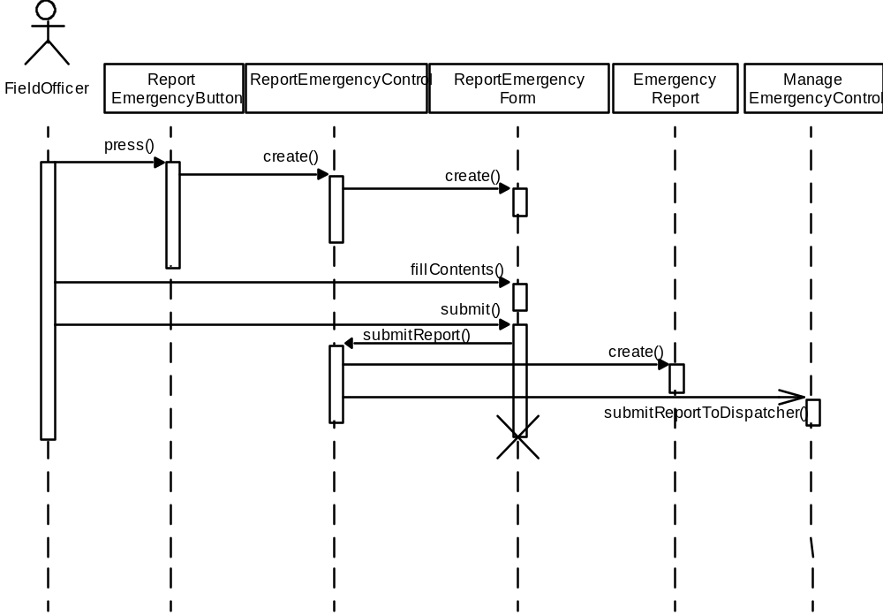
Example Sequence Diagram

Slide 23
Object
Object naming:
  syntax: [instanceName][:className]
  Name classes consistently with your class diagram (same classes).
  Include instance names when objects are referred to in messages or when several objects of the same type exist in the diagram.
The Life-Line represents the object’s life during the interaction
myBirthdy
:Date

Slide 24
Messages
An interaction between two objects is performed as a message sent from one object to another (simple operation call, Signaling, RPC)
If object obj₁ sends a message to another object obj₂ some link must exist between those two objects (dependency, same objects)

Slide 25
Messages (Cont.)
A message is represented by an arrow between the life lines of two objects
  Self calls are also allowed
  The time required by the receiver object to process the message is denoted by an activation-box
A message is labeled at minimum with the message name
  Arguments and control information (conditions, iteration) may be included

Slide 26
Return Values
Optionally indicated using a dashed arrow with a label indicating the return value.
  Don’t model a return value when it is obvious what is being returned, e.g. getTotal()
  Model a return value only when you need to refer to it elsewhere, e.g. as a parameter passed in another message.
  Prefer modeling return values as part of a method invocation, e.g. ok = isValid()

Slide 27
State
State
  State is a defined set of properties which describe an object or thing at a given time.
  State may change when the properties making up the state change.
An abstraction of the attribute of a class
  A condition that is satisfied by the attribute values of an object or subsystem
  State is the aggregation of several attributes of a class
  Incident: Active, Inactive, Closed and Archived
State has duration
Notes:
An object model describes the possible patterns of objects, attribute values and links that can exist in a system.
A dynamic model describes the possible patterns of states, events and actions that can exist in a system.
Over time, the objects stimulate each other, resulting in a series of changes to their states.
An individual stimulus from one object to another is called an event.
Events can be organized into classes. Events can be error conditions as well as normal occurences. Event as an object : Some events are only signals (OK), others have attributes associated with them (Unix signals: Bus error, Segment violation).
Attributes are shown in parentheses after the class name. Events are important for UI, Communication and Notification. Other groups have to worry about events as well, because the interaction between the subsystems should be via the Request Broker.
The response to an event depends on the state of the object receiving it. It can include a state change or sending of another event to another object and sending a event back to the sender (return result, ok, ...)
The Events and states are duals of one another: An event separates 2 states and a state separates 2 events.

Slide 28
UML Statechart Diagram Notation
Event trigger
With parameters
State1
State2
Event1(attr) [condition]/action
do/Activity
entry /action
Guard
condition
exit/action
A UML statechart diagram can be mapped into a finite state machine
Notes:
A state is drawn as a rounded box containing a name. The state name appears in bold face
A transition is drawn as an arrow from the receiving state to the target state. Event names are written on the transition arrow, optionally followed by one or more attributes within parentheses.
A condition is a Bollean function of object values, such as emission is above legal value. Conditions can be guards on transitions. A guarded transition fires only when the event occurs and the condition is true. Conditions are shown as expressions in square brackets following the event name and its parameter list.
An action follows the event name and/or the condition by the slash (/) character.
Events that cause an action without causing a state change are written inside the state box. Internal action and self-transition are different. When an internal action occurs, neither the entry nor exit action is executed, when a self-transition occurs, these actions are executed.
Events sent to other objects are shown in dashed lines.

Slide 29
UML statechart for Incident.
all reports
are submitted
Active
Inactive
Closed
Archived
numAllocatedResource == 0
when incident.date > 1yr.

Slide 30
Statechart diagram for 2Bwatch
State
Initial state
button1&2Pressed
button2Pressed
Blink
Increment
Hours
Hours
Transition
button1Pressed
Event
button1&2Pressed
Blink
button2Pressed
Increment
Minutes
Minutes
button1Pressed
button2Pressed
Stop
Blink
Increment
Blinking
Seconds
Seconds
button1&2Pressed
Final state

Slide 31
Modeling Inheritance Relationship between Objects
Generalization
  Eliminate redundancy from the analysis model
  Two or more classes share attributes or behavior
  Similarities are consolidated into super class
    badgeNumber
PoliceOfficer
badgeNumber:Integer
FieldOfficer
Dispatcher

Slide 32
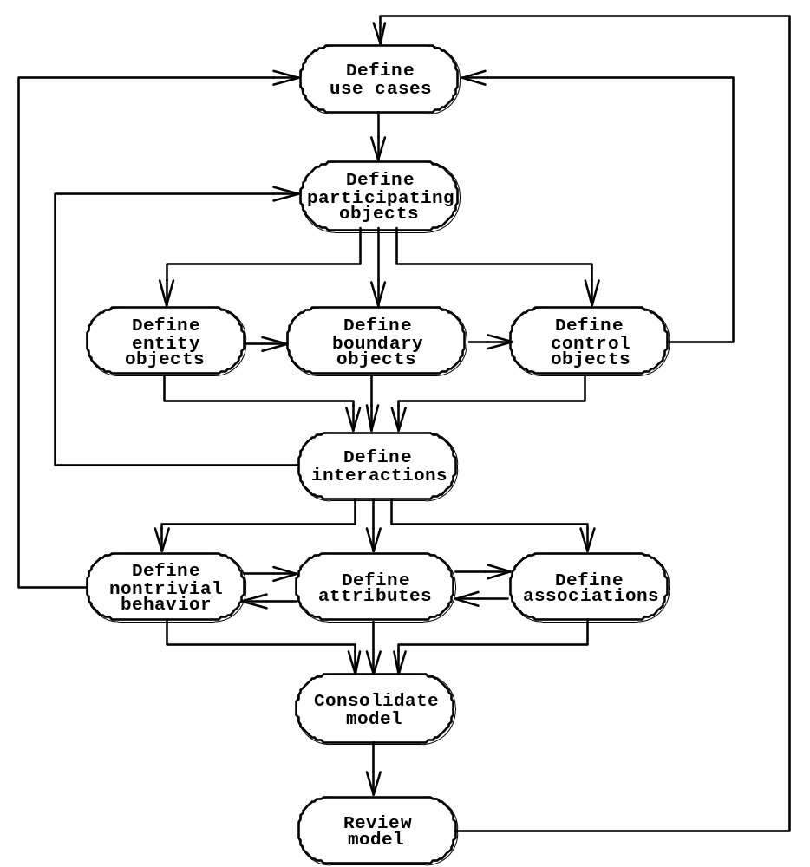
Analysis activities
(UML activities diagram).

Slide 33
QUESTIONS ?

